Slide 1
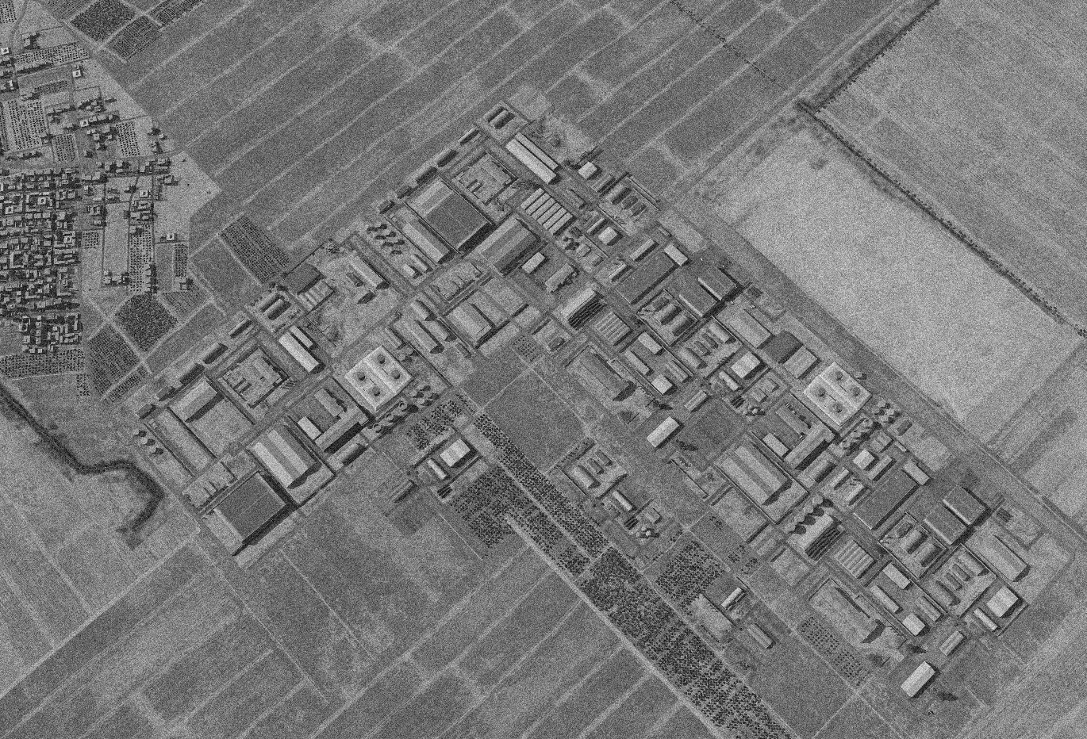

SYTGT012 JIRAH SW AMMUNITION FACTORY
N
12
6
7
8
10
4
5
9
3
2
Storage tanks
1
DESIRED POINT of IMPACT:
DPI 10 - N36 04.508 E 37 54.277 / 1156ft / 2000lb PGM
DPI 9 - N36 04.487 E 37 54.433 / 1156ft / 2000lb PGM
DPI 8 - N36 04.562 E 37 54.417 / 1150ft / 2000lb PGM
DPI 7 - N36 04.553 E 37 54.410 / 1151ft / 2000lb PGM
DPI 6 - N36 04.536 E 37 54.363 / 1153ft / 2000lb PGM
DPI 5 - N36 04.487 E 37 54.314 / 1153ft / 2000lb PGM
DPI 4 - N36 04.472 E 37 54.300 / 1153ft / 2000lb PGM
DPI 3 - N36 04.448 E 37 54.368 / 1148ft / 2000lb PGM
DPI 2 - N36 04.445 E 37 54.386 / 1148ft / 2000lb PGM
DPI 1 - N36 04.330 E 37 54.331 / 1153ft / 2000lb PGM
Mosque
Storage tanks
CDC - High density civilian housing 300m West of the facility. Chemical storage tanks located in close by facilities pose pollution risk if struck.

Slide 2
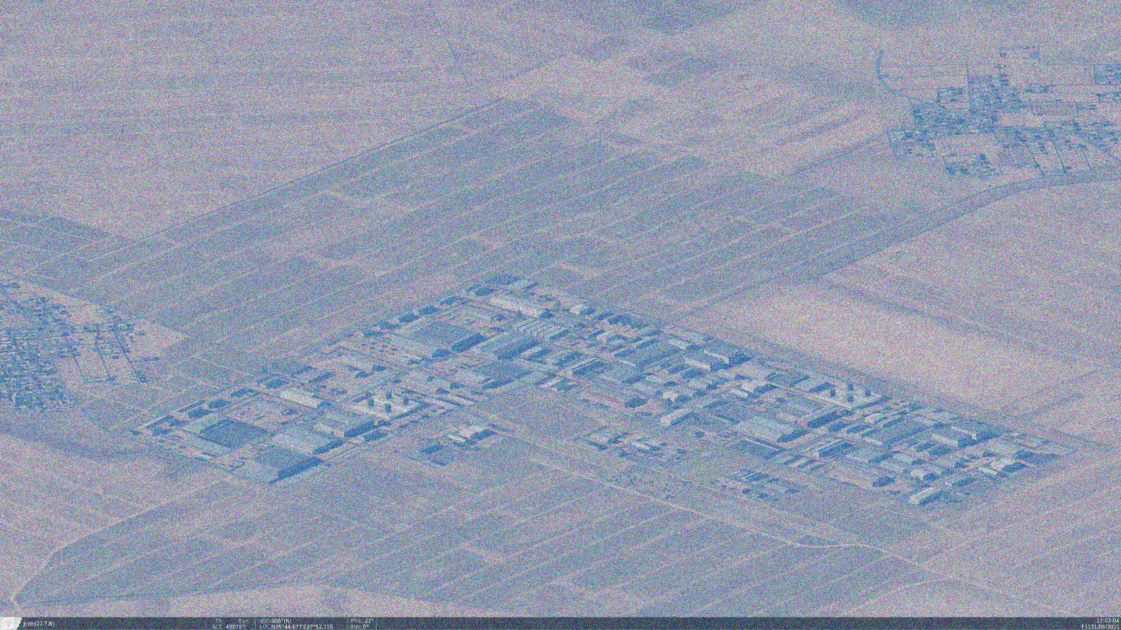
OPARTGT011 RAQQA AMMUNITION FACTORY
N
Known to be producing a-g rockets which includes MSLR artillery rockets.
The facility is embedded within a large industrial complex, only the northernmost part is used to produce rockets.
10
6
7
8
4
5
9
Storage tanks
3
2
1
Mosque
Storage tanks
CDC - High density civilian housing 300m West of the facility. Chemical storage tanks located in close by facilities pose pollution risk if struck.

